Slide 1
. Mom! OK, Two more Years
DR GURBAKSH SINGH

Slide 2
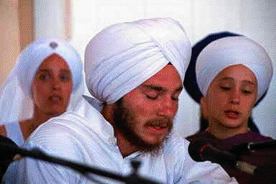
I was invited to an annual Sikh Youth Leadership camp held in Michigan, USA, in order to discuss important current issues with the participants.
I observed one young man playing a good leadership role.
He was always precise and organized in analyzing the issues and expressing his views very carefully.
He was an amritdhari Sikh I could not hold myself from appreciating the competence of the youth and his devotion to the Sikh faith.
When talking to the director of the camp, I commented about that participant, “How lucky are his parents?... I am very much impressed by his performance at the camp.”
The director asked me with surprise, “Don’t you know him?”
He then told me the touching background of the boy as below

Slide 3
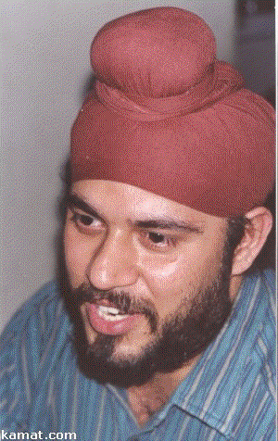
He is in the final year of the law school.
When he was in his high school, he attended a Sikh youth camp and decided to keep his hair uncut.
His parents did not agree to his decision.
They insisted that he must cut his hair. The boy noted the aggressive attitude of his parents, particularly his mother,
who said, “I cannot handle your long hair; you must go with your father and get your hair cut.”
The boy said, “Okay. Mom, I will get my haircut as you wish. There are only two more years for you to order me like that.
After that, you cannot touch my hair. You do not know the importance of the uncut hair of a Sikh.

Slide 4
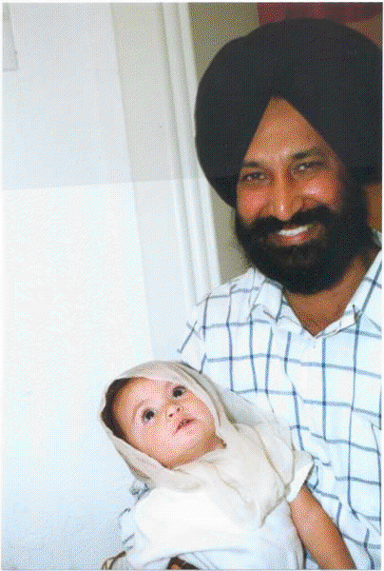
. Had you attended only one Sikh youth camp, you would have known their value and would have been pleased with my decision.”
Later, the youth stopped cutting hair and took amrit. He can perform Kirtan, and is one of the senior counselors at the camp.
I met the boy later at a kirtan function in Toronto; he was then a practising Sikh lawyer.
There are many such cases where participants attending the Sikh youth camps have adopted new lives.
The lesson we can learn from this episode is that, if a youth attends the camp with a receptive mind, it can change his life and put him on the right track.

